Slide 1

ANGULAR 4

Slide 2
Data Binding in Angular Forms
Data Binding and ngModel
Creating a Model Object
Binding to Your Model
Calling a Method in Place of Binding
Binding a Checkbox
Binding Radio Buttons
Binding a Select Control

Slide 3
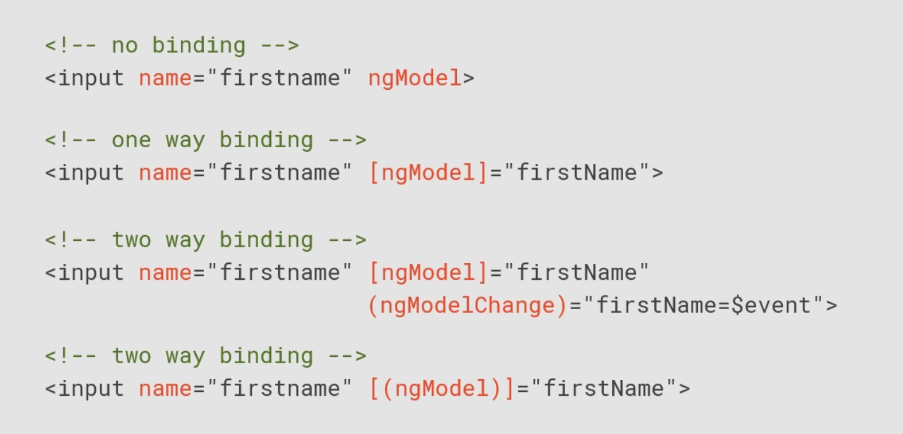
Data Binding in Angular Forms
Data Binding and ngModel

Slide 4
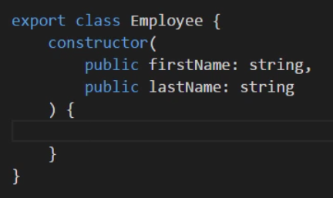
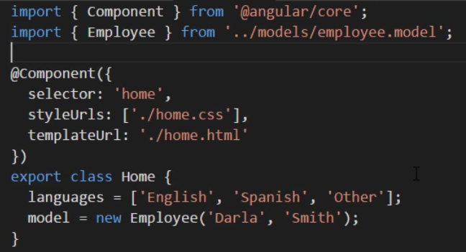
Data Binding in Angular Forms
Creating a Model Object
Model.ts
1
Component.ts
2

Slide 5
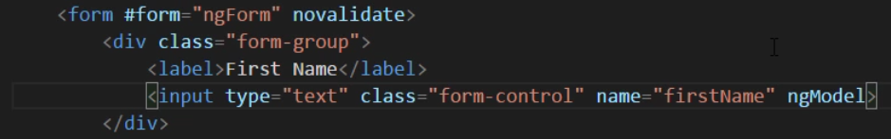
Data Binding in Angular Forms
Binding to Your Model
No Binding
The model is out of sync with the form.

Slide 6
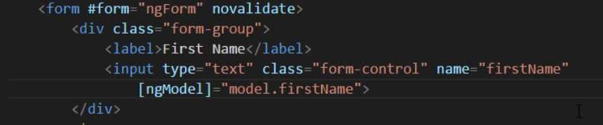
Data Binding in Angular Forms
Binding to Your Model
One-way Binding
The form is aware of the model value.

Slide 7
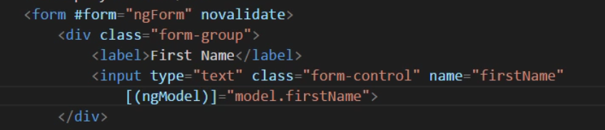
Data Binding in Angular Forms
Binding to Your Model
Two-way Binding
The form and model are in sync.

Slide 8

Data Binding in Angular Forms
Binding to Your Model
Demo

Slide 9
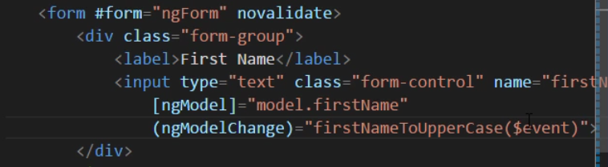
Data Binding in Angular Forms
Calling a Method in Place of Binding
In order to be able to cal a function, we need to use the long sintax version.

Slide 10
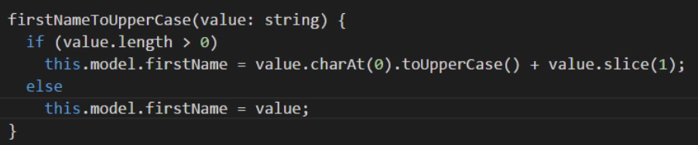
Data Binding in Angular Forms
Calling a Method in Place of Binding
Demo

Slide 11
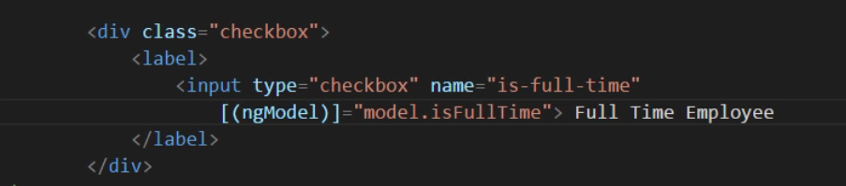
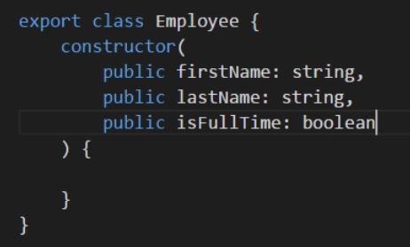
Data Binding in Angular Forms
Binding a Checkbox
component.html
model.ts
Similar sintax
Always bind to a boolean value.

Slide 12
Data Binding in Angular Forms
Binding a Checkbox
Demo

Slide 13
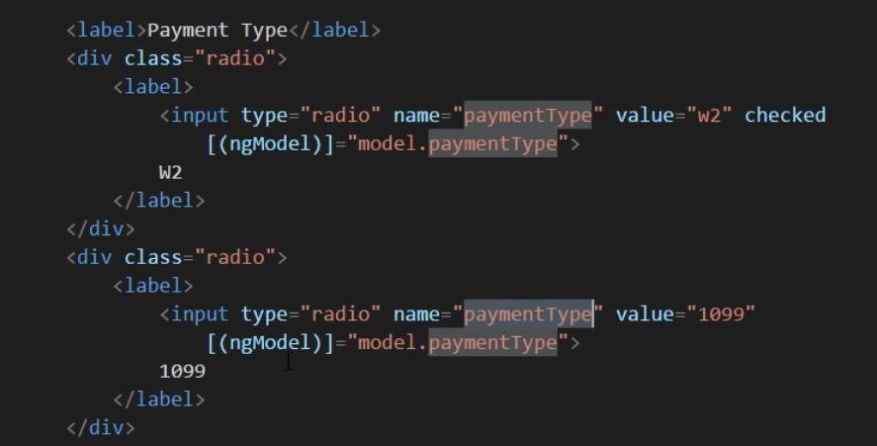
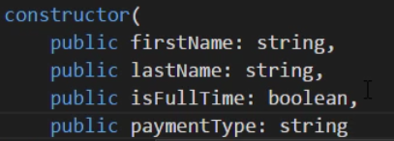
Data Binding in Angular Forms
Binding Radio Buttons
component.html
model.ts

Slide 14
Data Binding in Angular Forms
Binding Radio Buttons
Demo

Slide 15
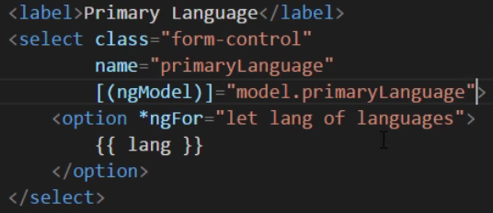
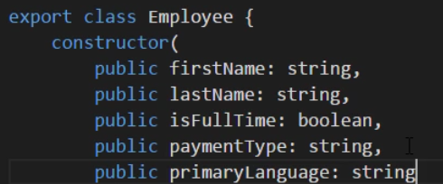
Data Binding in Angular Forms
Binding a Select Control
component.html
model.ts

Slide 16
Data Binding in Angular Forms
Binding a Select Control
Demo

